Slide 1

Coursera Capstone IBM Applied Data Science Capstone Franchise Development in Belarus
By: Yakuta Aleh January 2020

Slide 2
Business problem
Choosing a city to open a new franchise point is one of the most important decisions that will determine whether franchise development is successful or unsuccessful.
Purpose: to analyze and choose the best cities of Belarus to open a point of a certain type
This project is relevant in connection with the development of franchise business in Belarus
Business question
When opening a franchise in Belarus, in which cities (in addition to large ones) would you recommend developing your business in the first place?

Slide 3
Data
Required data
List of cities in Belarus
Latitude and longitude of cities
Population data for different years, salary for different years
Data sources
Data from the website of the National Statistical Committee (https://www.belstat.gov.by/)
Geocoder package for obtaining latitude and longitude coordinates
Foursquare API for receiving data on institutions of various types in cities

Slide 4
Methodology
Data on cities, population and wages received from BelStat website and converted to Excel spreadsheet
Clearing data, deriving population and wage ratios as well as trends in their decrease or increase over time
Getting latitude and longitude coordinates using Geocoder
Using the Foursquare API to get information on establishments in each city
Obtaining data on all types of establishments for which we can conduct an analysis; when analyzing a new type, this item can be ignored
Using a filter to select data for a specific type of establishment
Clustering cities using the k-means method
Visualization of clusters on a map using a map
Analysis of the resulting clusters and the formation of the conclusion

Slide 5
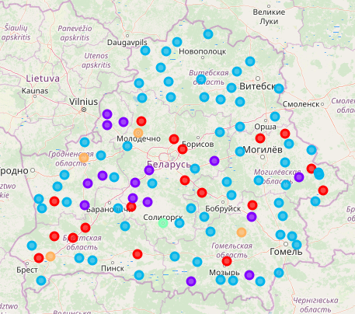
Results
The k-means clustering results show that we can classify neighborhoods by 5
City analysis clusters for the type of Restaurant establishments, depending on the attractiveness for opening a new institution of this type:
Cluster 3 (green): high salary, high strength, positive growth rates.
Cluster 4 (orange): average salary, high strength, positive growth rates.
Cluster 0 (red): cities with a small number but not the lowest salary.
Cluster 2 (blue): unattractive cities, with a small number.
Cluster 1 (purple): indicates cities that already have establishments of this type

Slide 6
Discussion and recommendations
It can be noted that, first of all, in order to open a new franchise point, it is necessary to pay attention to cities where there are no establishments of this type, but at the same time a high population and relatively high wages, clusters 3 and 4.
Next, pay attention to the middle-income cities of clusters 0 and 2. Avoid cities from cluster 1, as there are already establishments of this type and competition will not always positively affect the further development of the business.
On the other hand, this project shows how little data we have on open access cities.

Slide 7
Conclusion
In this project, we went through the process of identifying a business problem, determined the necessary list of data, engaged in their extraction and purification, and then used machine learning by clustering data in 5 clusters based on their similarities. In conclusion, we provided our recommendations based on an analysis of the resulting clusters.
The results of the analysis will help the entrepreneur to determine the most profitable and promising way to develop his own franchise in the cities of Belarus.

Slide 8


